Slide 1
The Flying Canoe
La Chasse-Gallerie

Slide 2
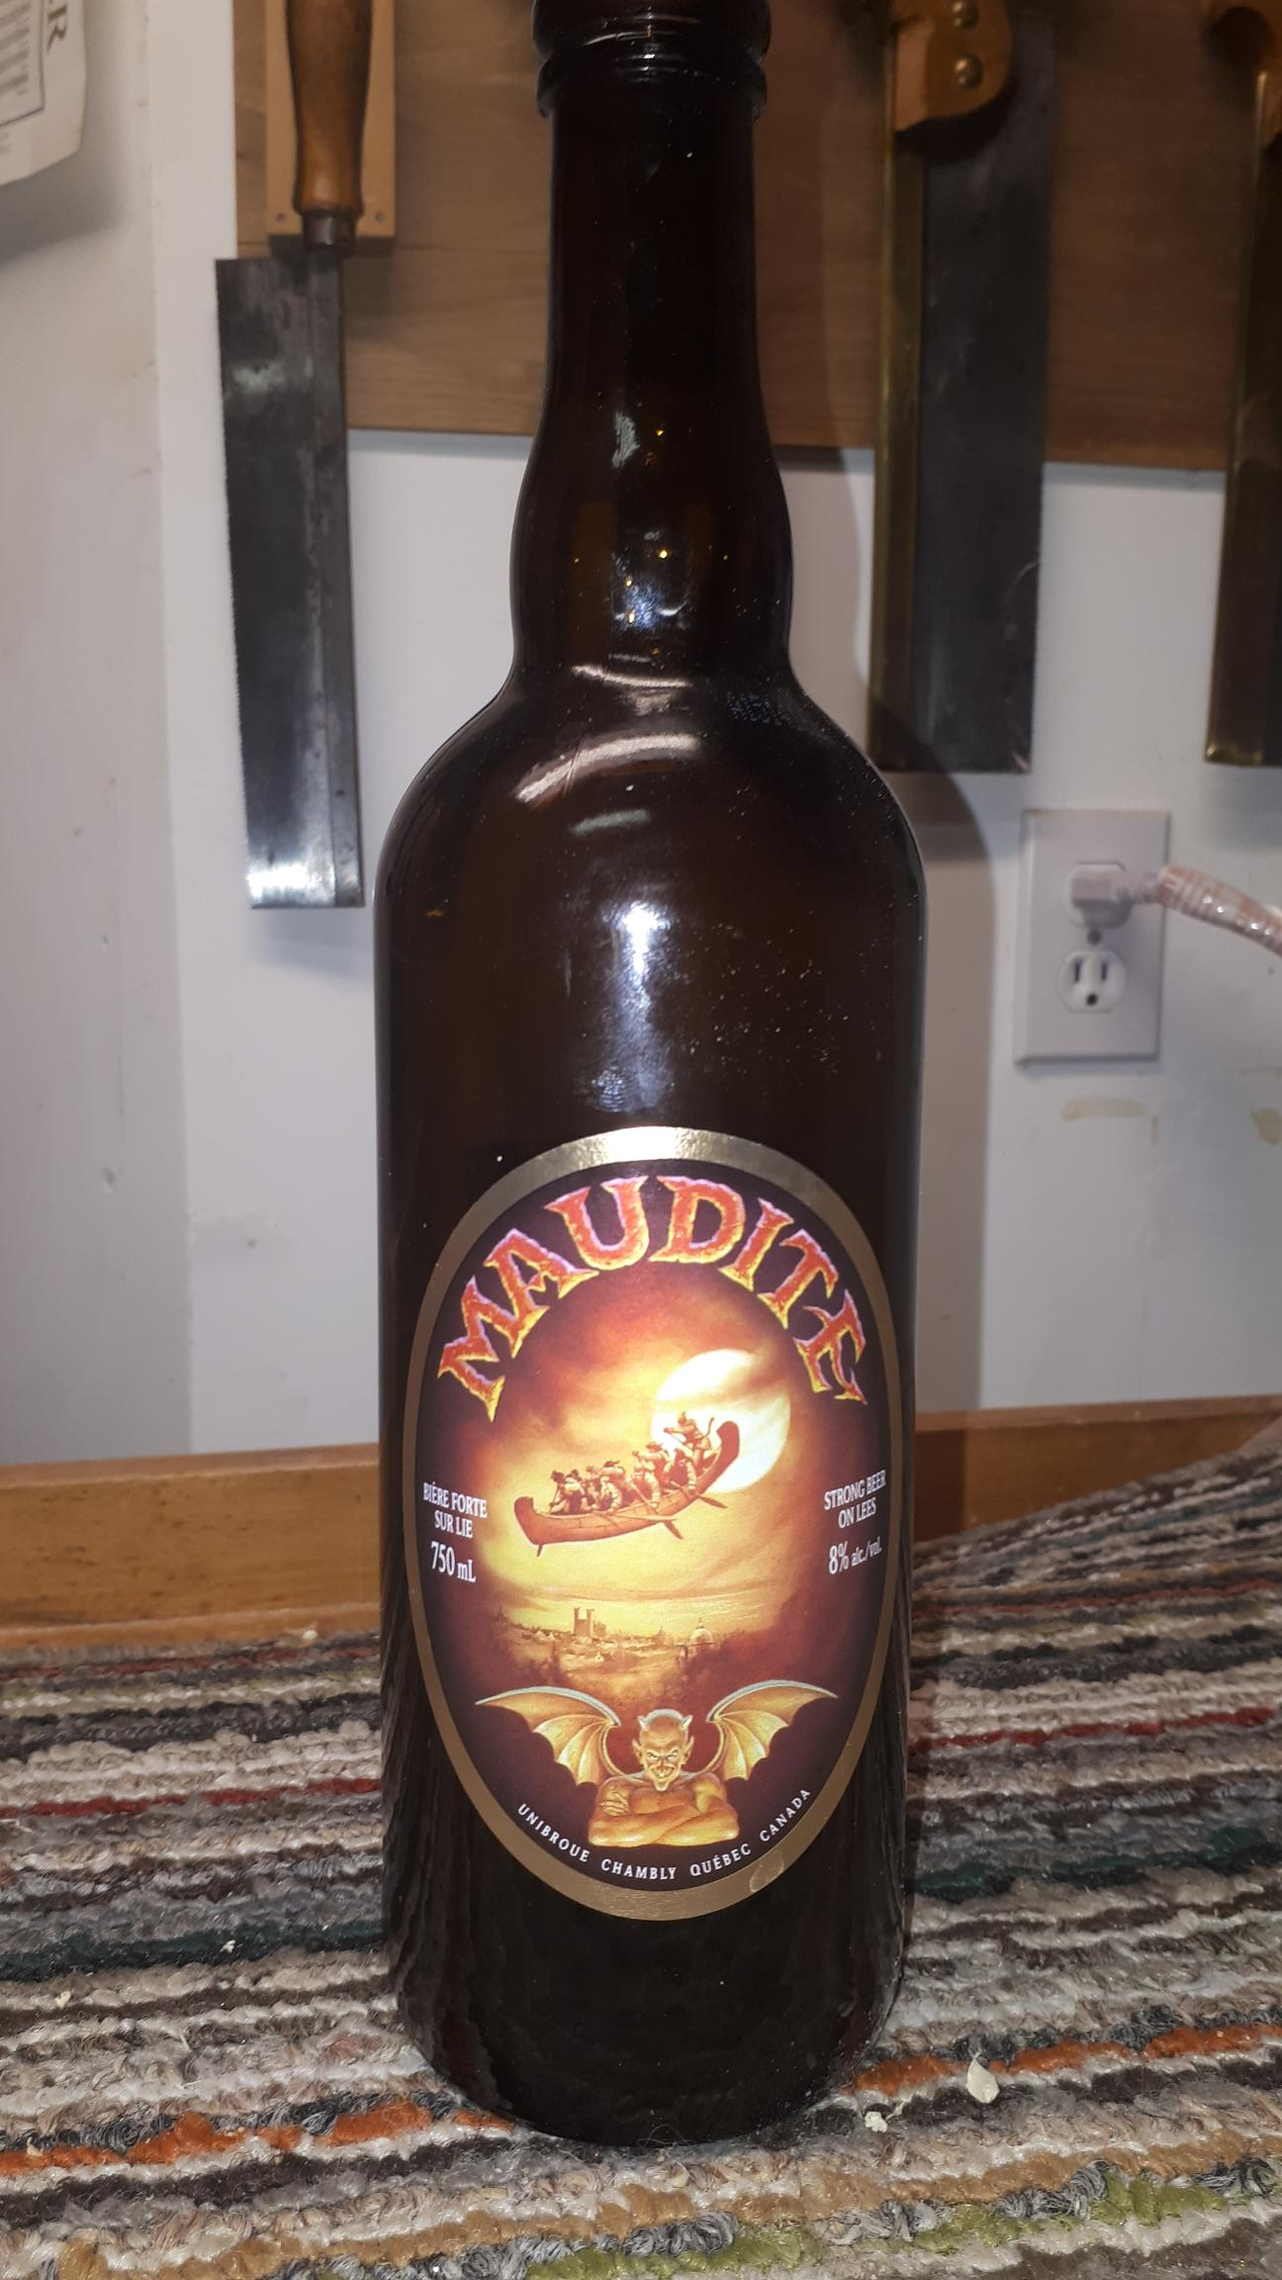

Slide 3
Carving by Gil Bourgault
36in x 20in
Colour is ageing + or- stain
Not sure original finish varnish or shellac

Slide 4
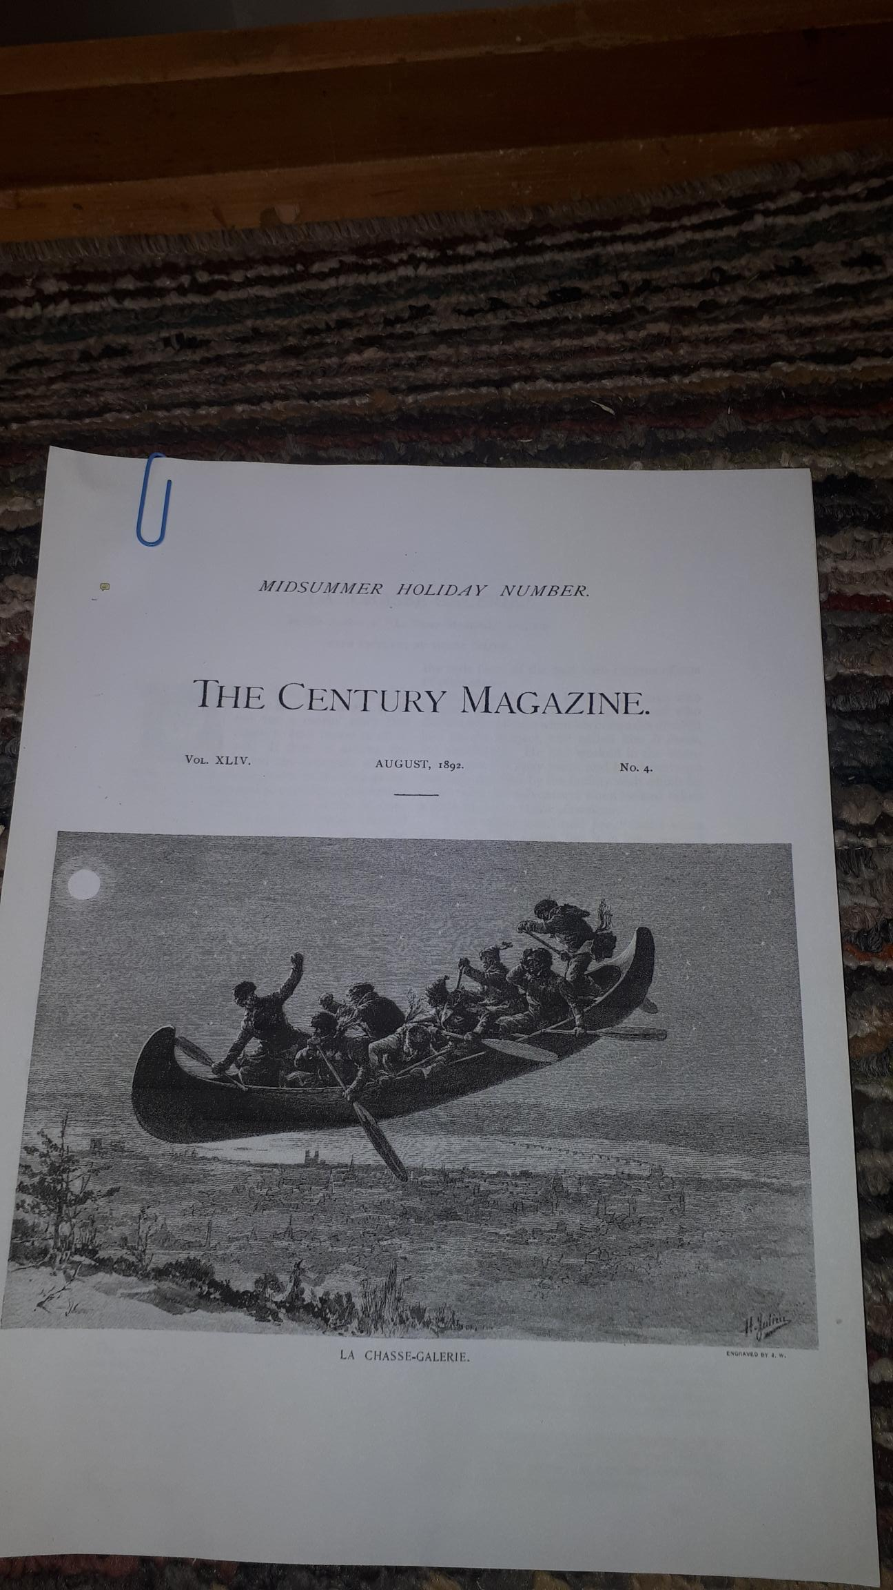
The Flying Canoe
Turns out to be an Illustration by Henri Julien for a magazine article

Slide 5
La Chasse-Gallerie, published in English in the Century Magazine,a precursor of Harpers magazine, in 1893
This version of the French Canadienne legend was written by Honore Beauregard
Chasse –Gallerie translates to the haunted hunt but more commonly known as the flying canoe
A saga…..

Slide 6
A preliminary scetch or caving of the canoe

Slide 7
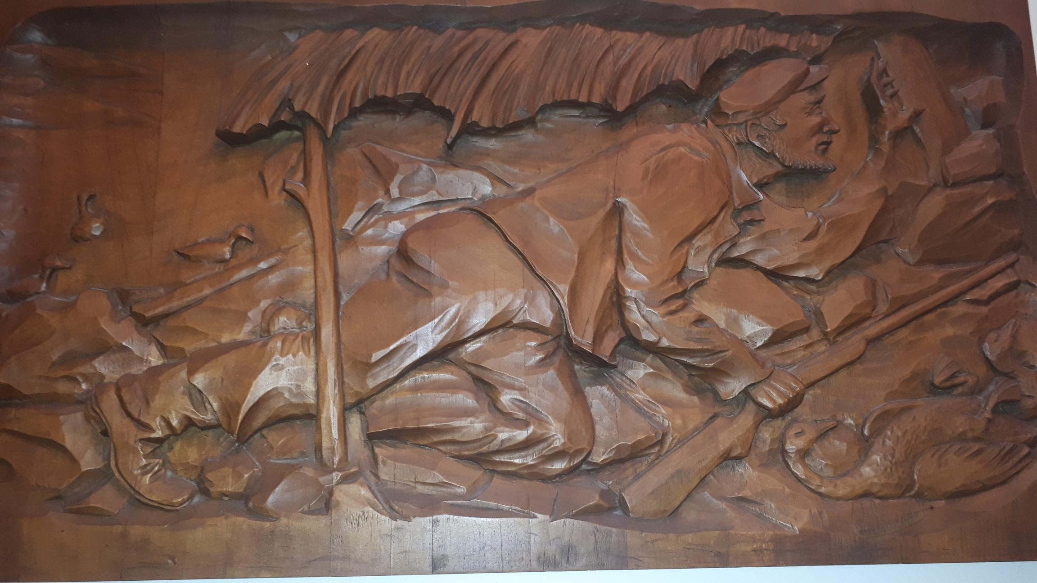
The troubles begin
Testing stains etc

Slide 8
