Slide 1
Atlantic Woodworkers’ Association
Virtual sessions
September 2021

Slide 2
Agenda
Meeting format - review
Safety Second - Calum
Tech/ Text/ Tools - Darryl/Stephen/Brad
Short Cuts - Brad
AWA Primetime - none
Show and Tell / Challenge - What did you make this summer?
Final Word - December meeting comes up fast

Slide 3
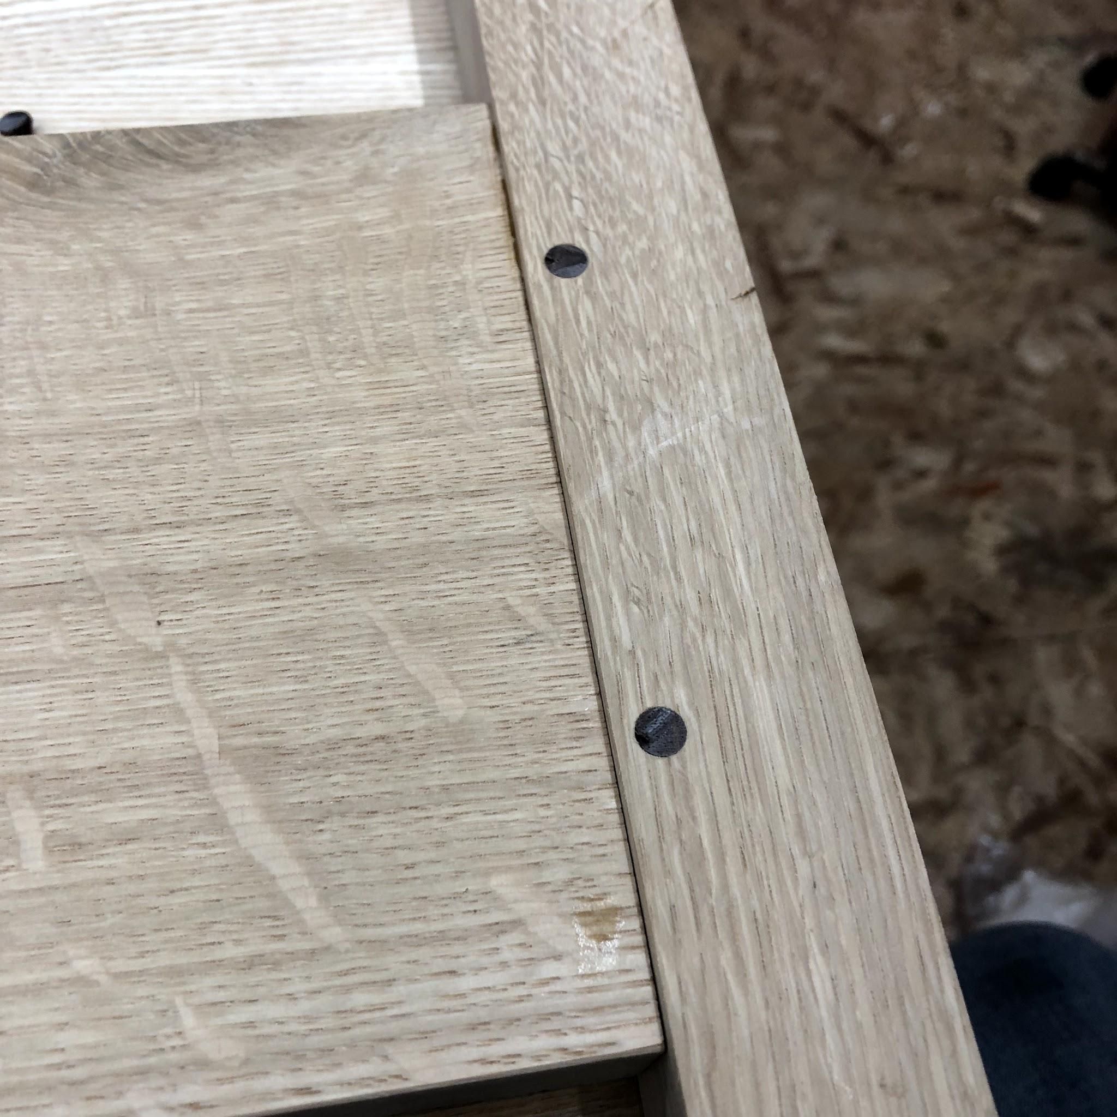
Mortise & Tenon joinery: Drawboring
Brad Holley
Drawboring mechanically reinforces a typical M&T join using an offset wooden peg
The join pre-dates the use of clamps
Useful now in applications where clamps might not be long enough and/or sufficient on their own

Slide 4
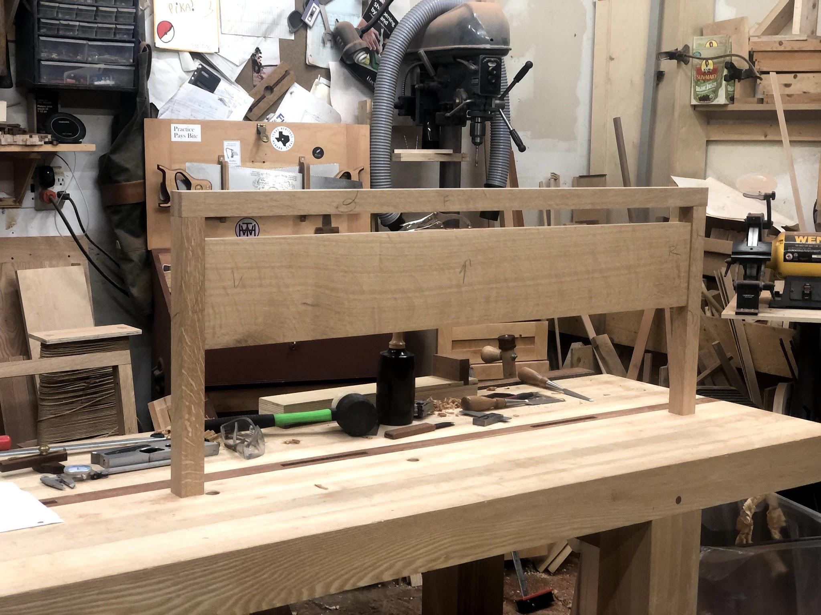
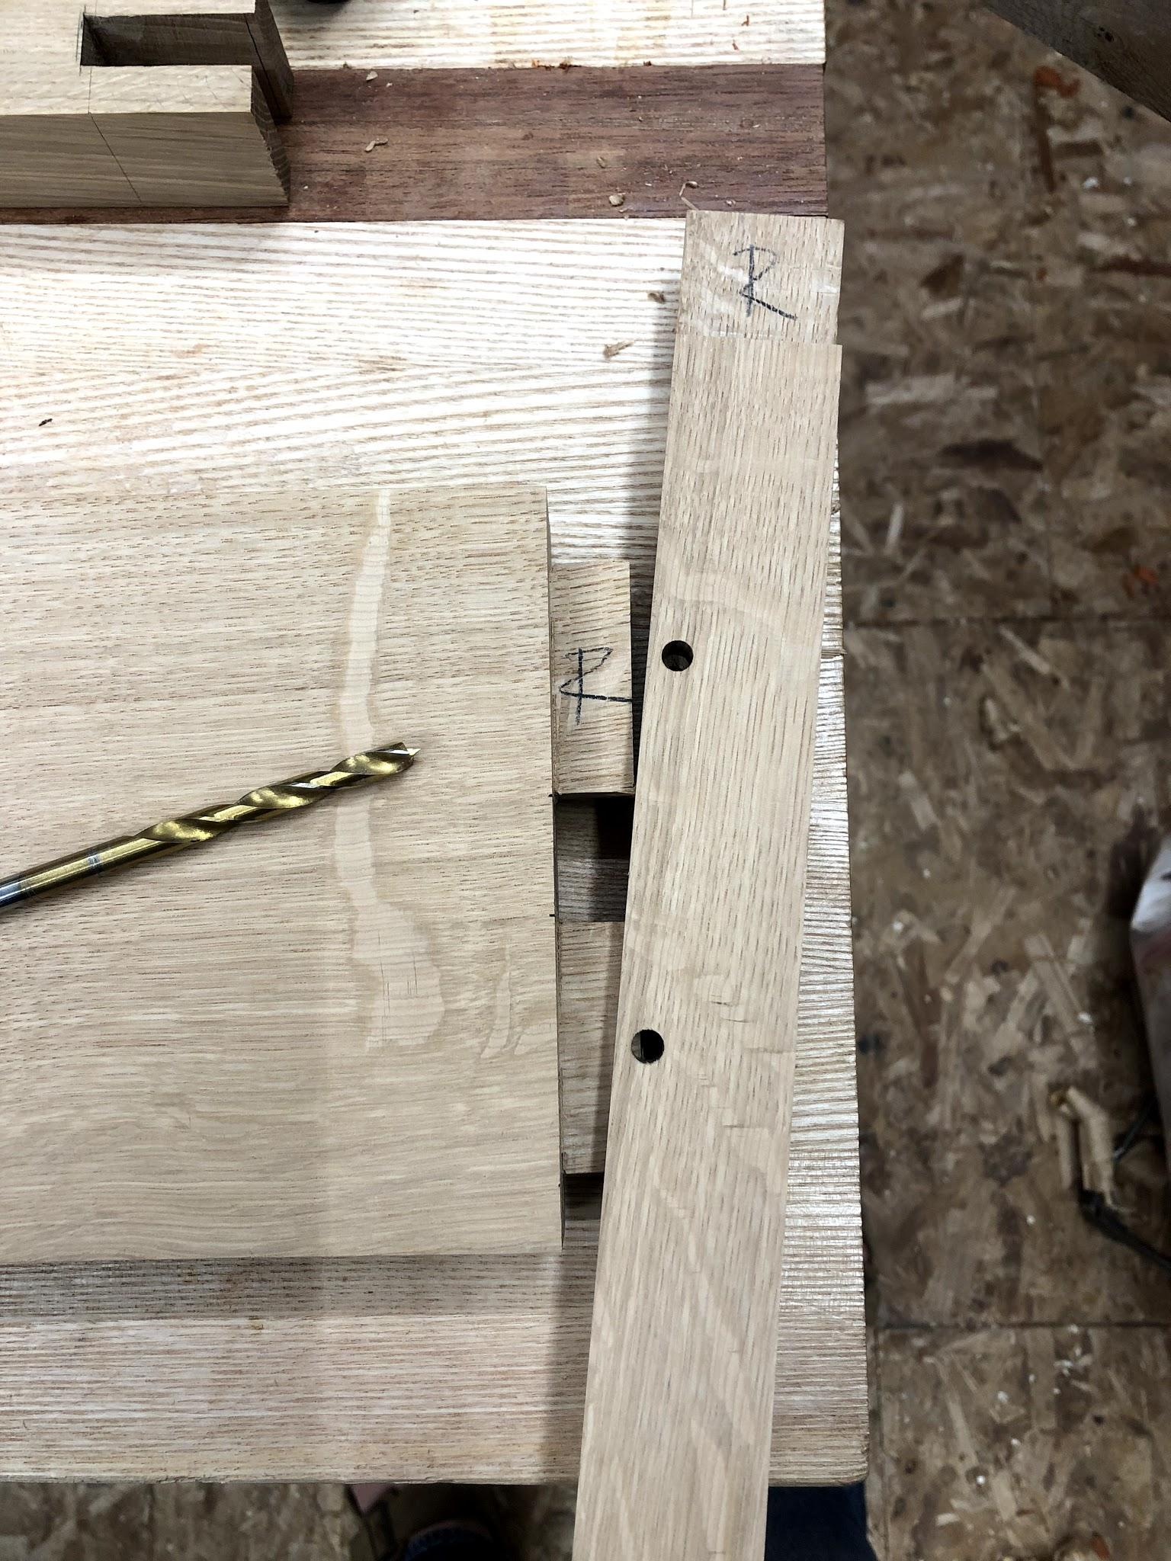
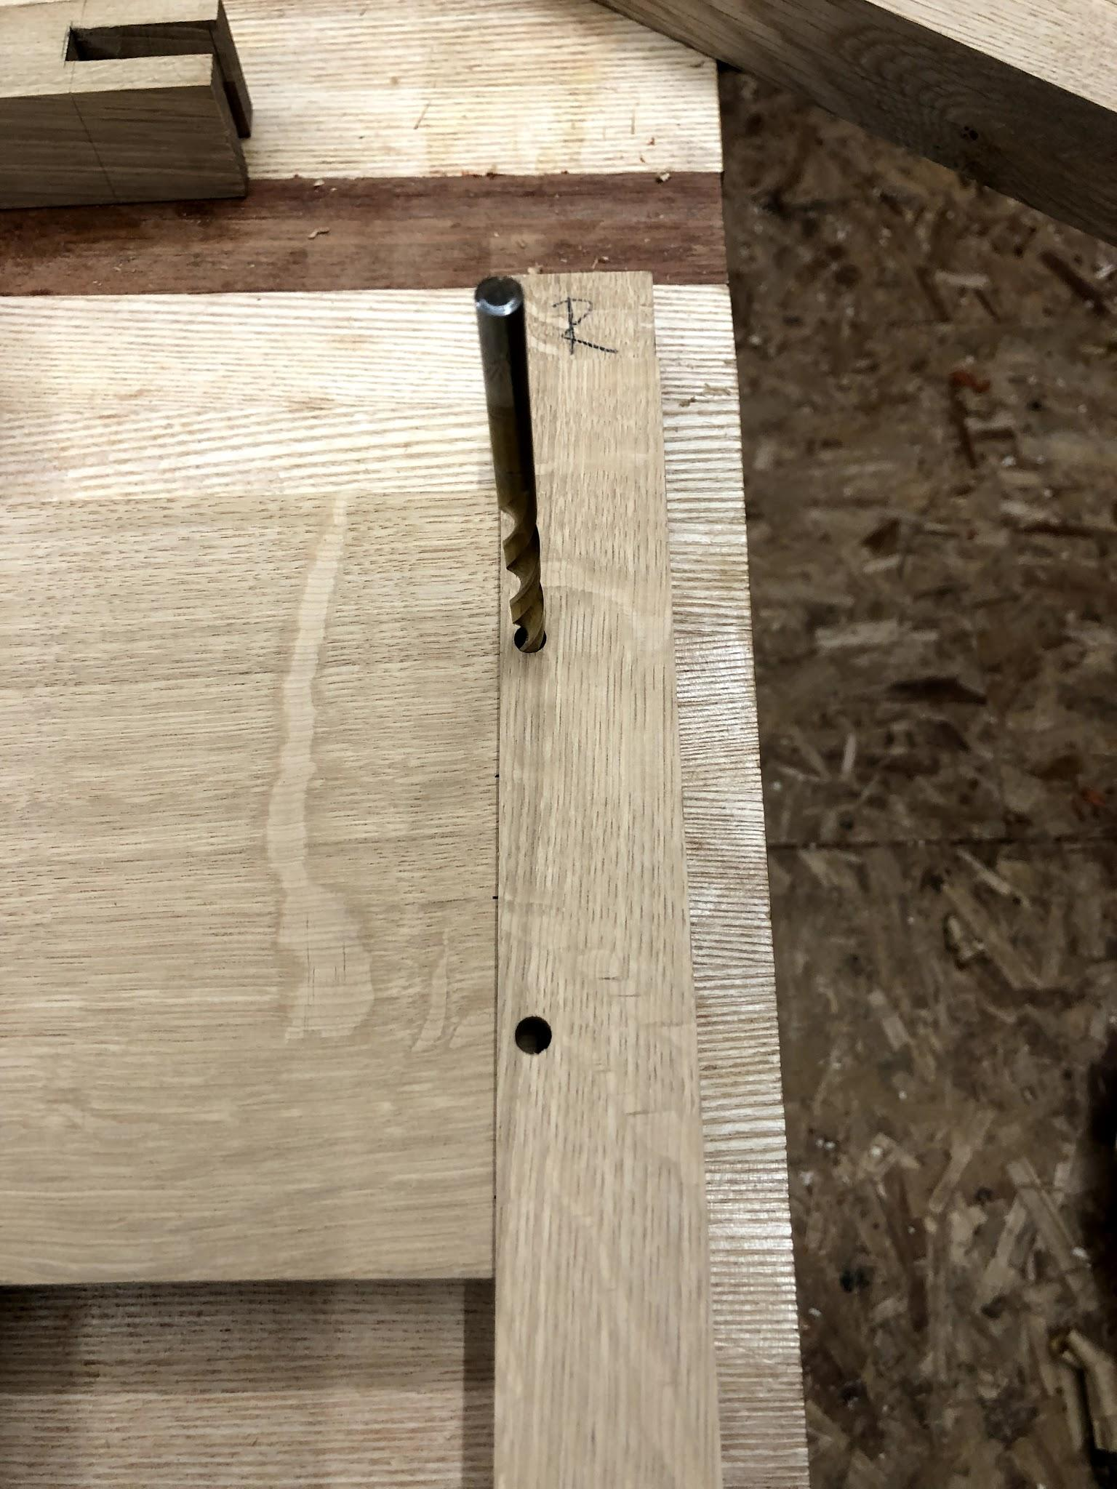
MORTISE & TENON JOINERY: DRAWBORING
A hole matching the diameter of the peg is first drilled through the mortise piece - typically ½” or more from the edge
Holes can be offset from one-another to avoid splitting along the grain
The location of that hole is then transferred to the tenon piece using just the brad point

Slide 5
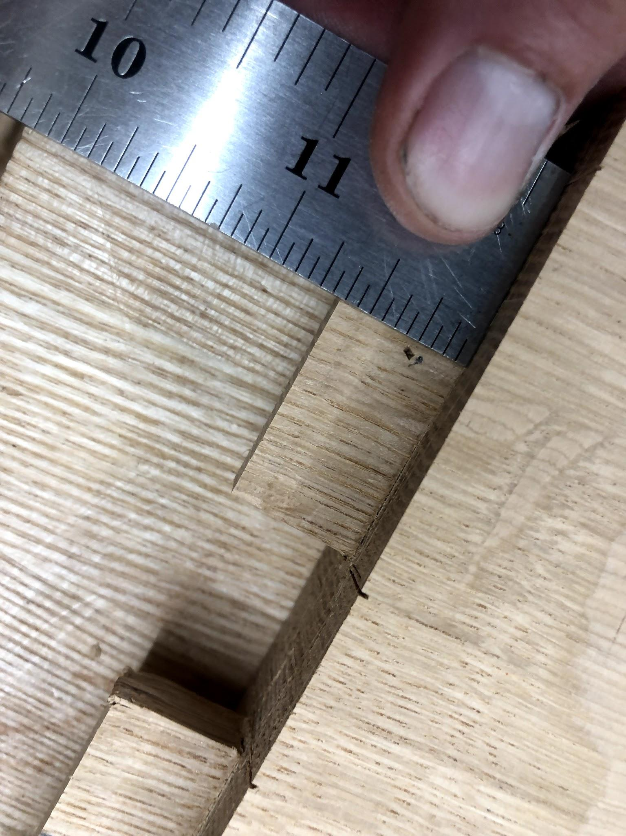
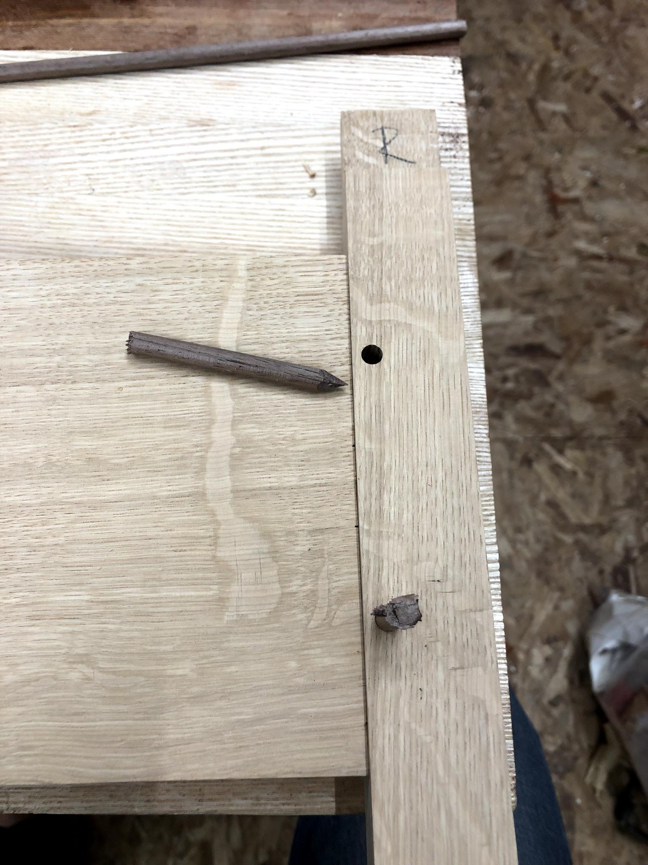
MORTISE & TENON JOINERY: DRAWBORING
The mark is moved slightly towards the shoulder of the tenon (1/16” is often enough)
A sharpened peg is driven through the hole which pulls the join in tight (aided by a drawbore pin
The pin actually bends as it goes through the offset hole

Slide 6
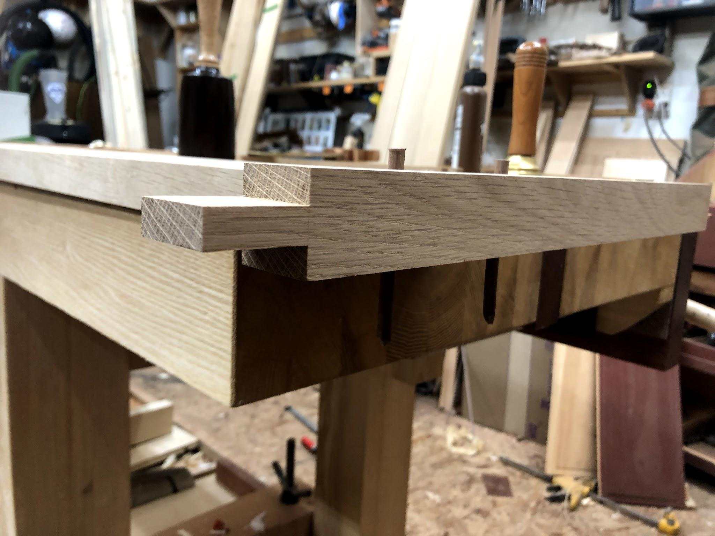
MORTISE & TENON JOINERY: DRAWBORING
After the pin is driven through the joint, it is cut flush to the surface of the piece and sanded clean
Paul Sellers has a YouTube post about this technique: https://www.youtube.com/watch?v=iblkJnlmg4w
See also article by Christopher Schwarz in Popular Woodworking Autumn 2005, 12-15

Slide 7
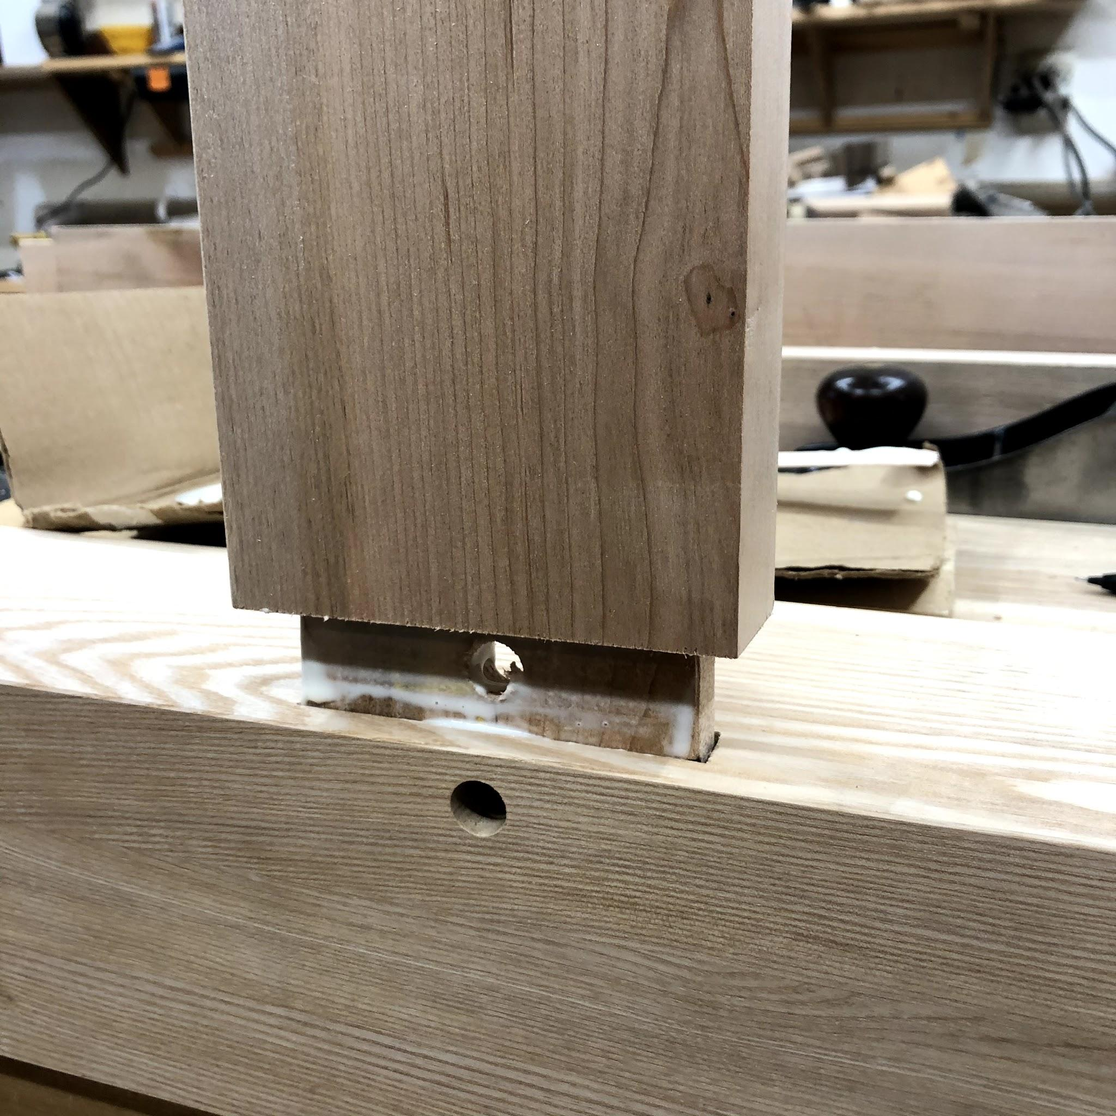
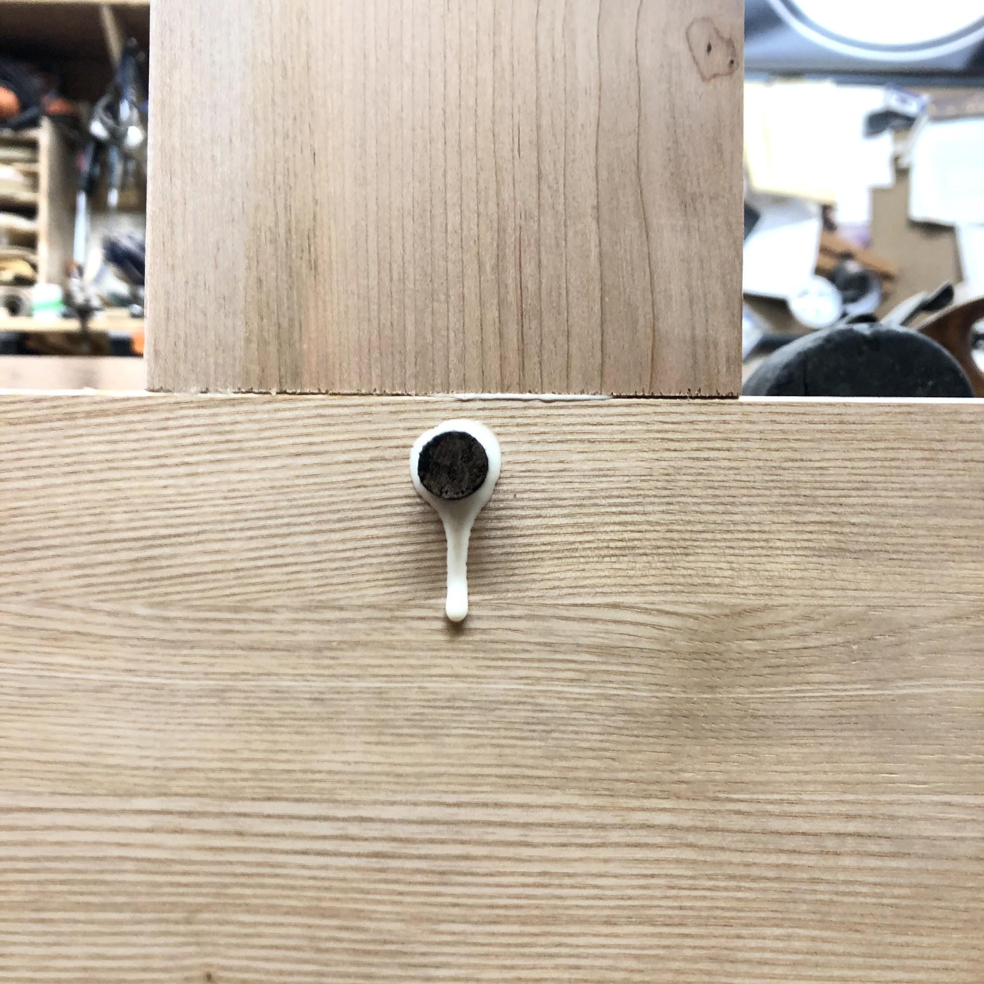
MORTISE & TENON JOINERY: DRAWBORING
Applications: permanent joins found in:
Windows and doors
Frames
Leg to apron joins
Timber framing

Slide 8
Tech/ Text/ Tools

Slide 9
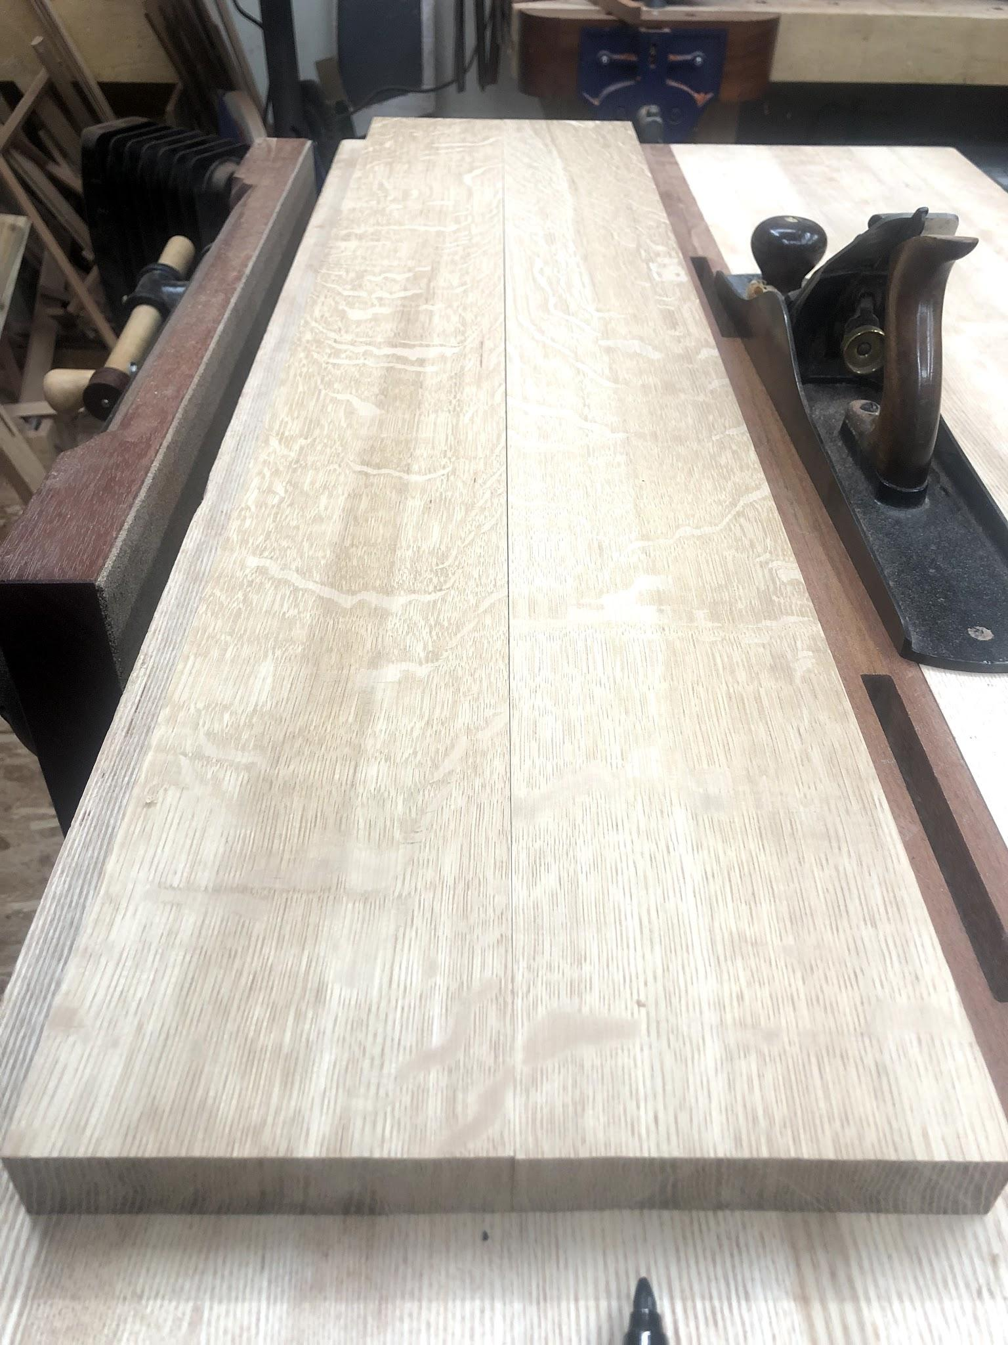
Short Cuts -
Sprung Joints
“Springing” a glue joint - such as for a table top or panel, by planing a slight cove makes for tighter joins

Slide 10
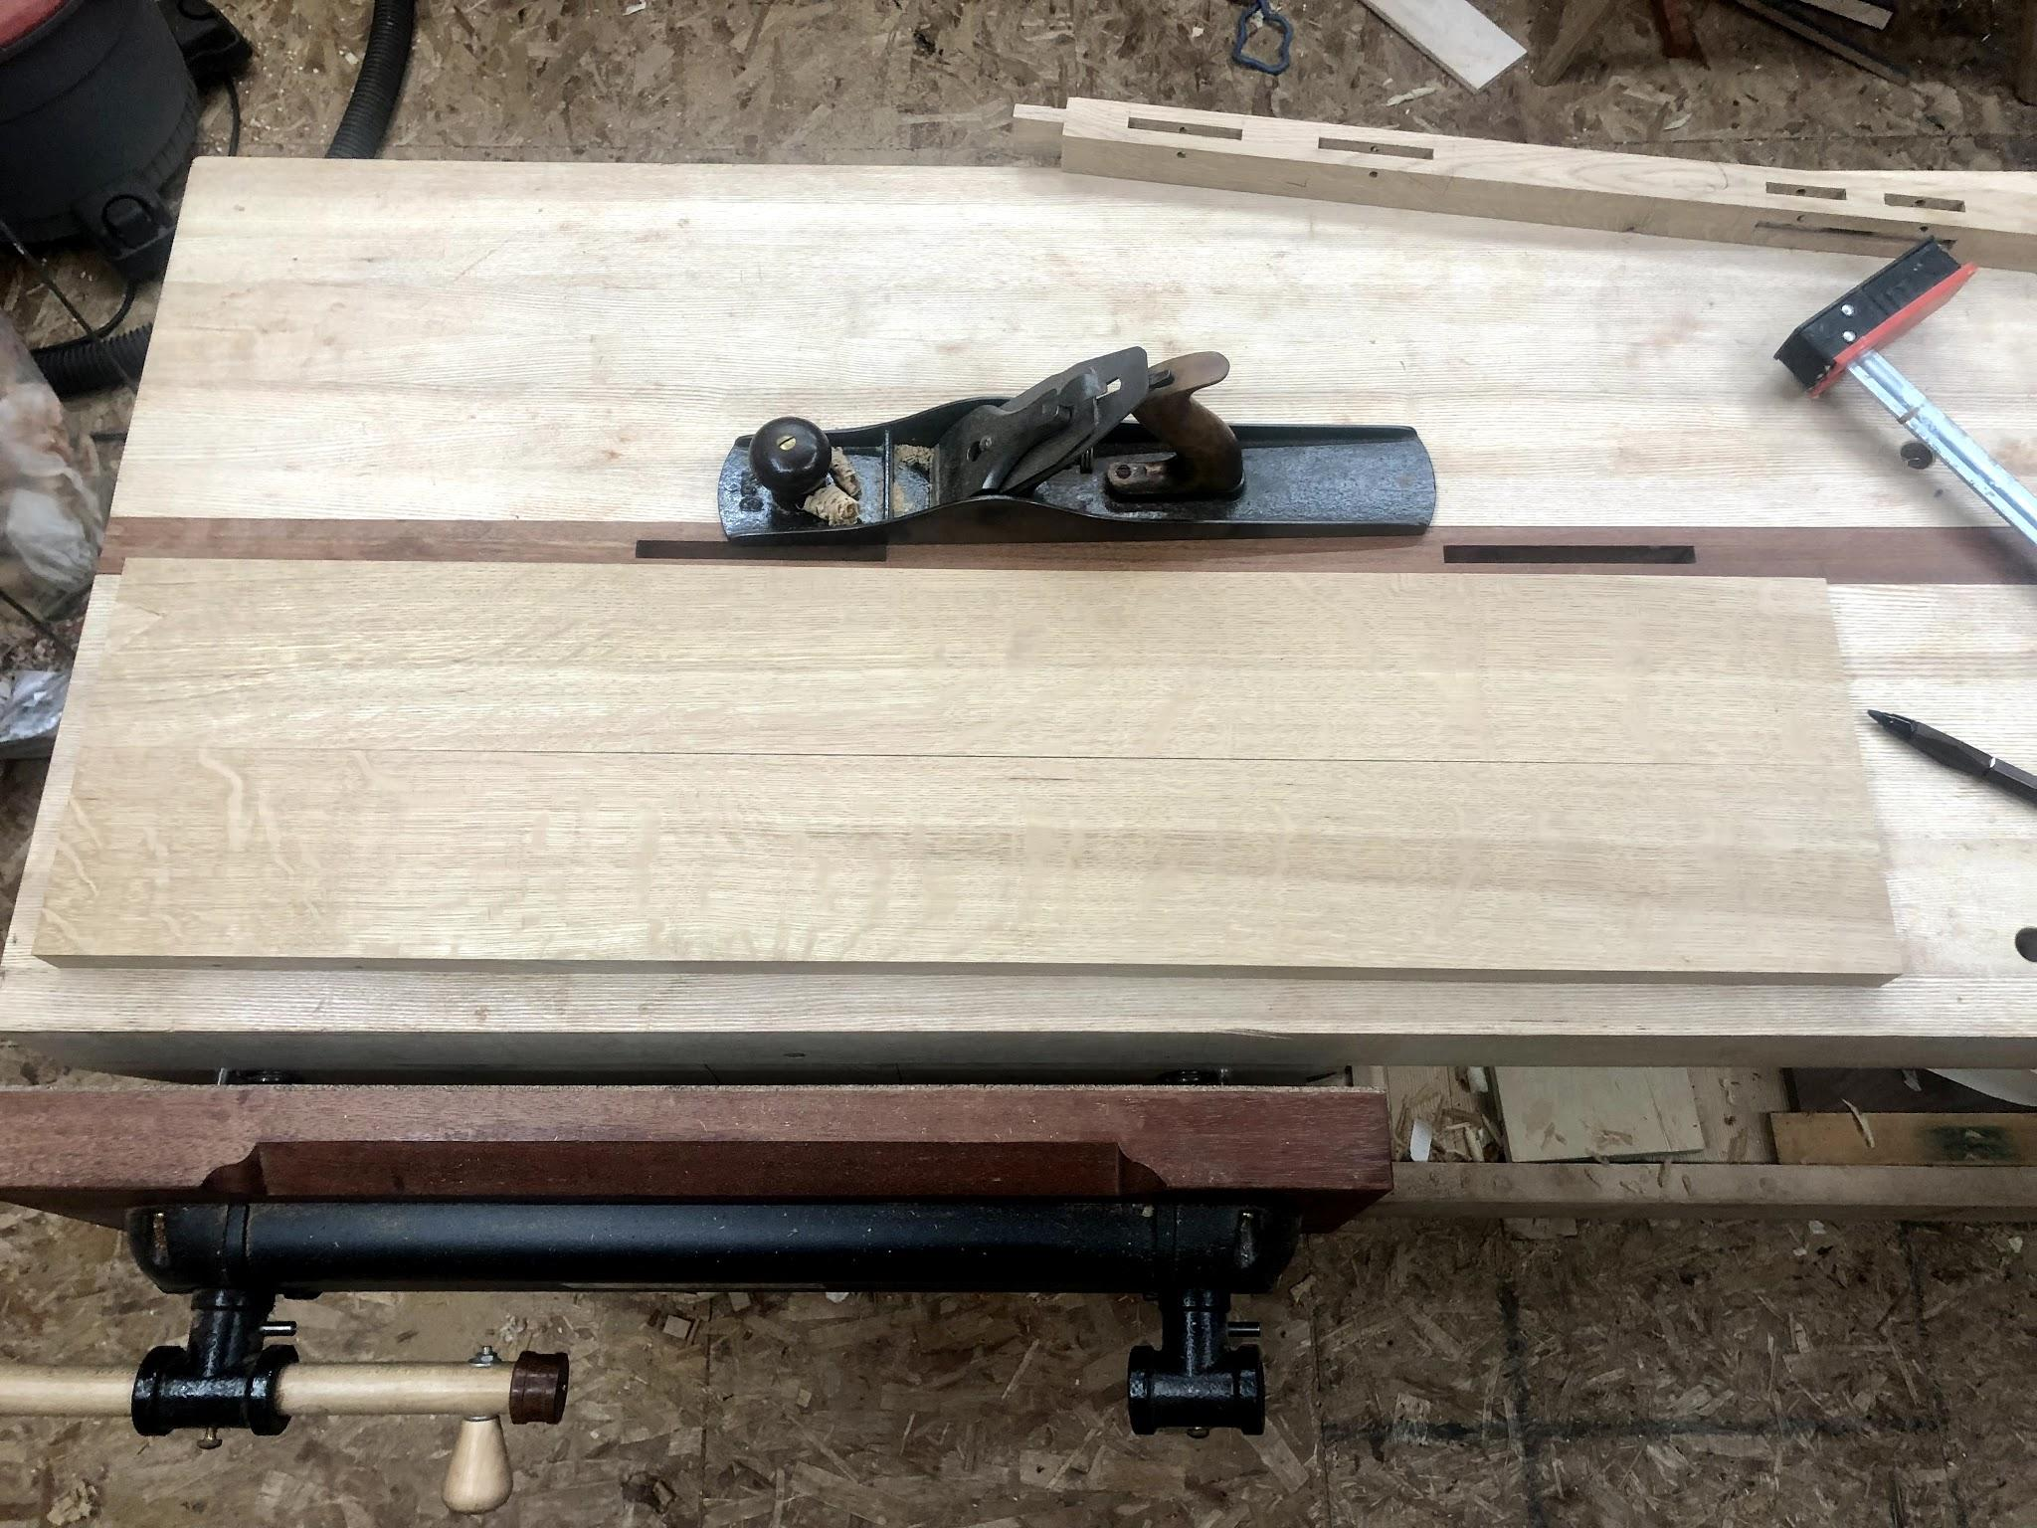
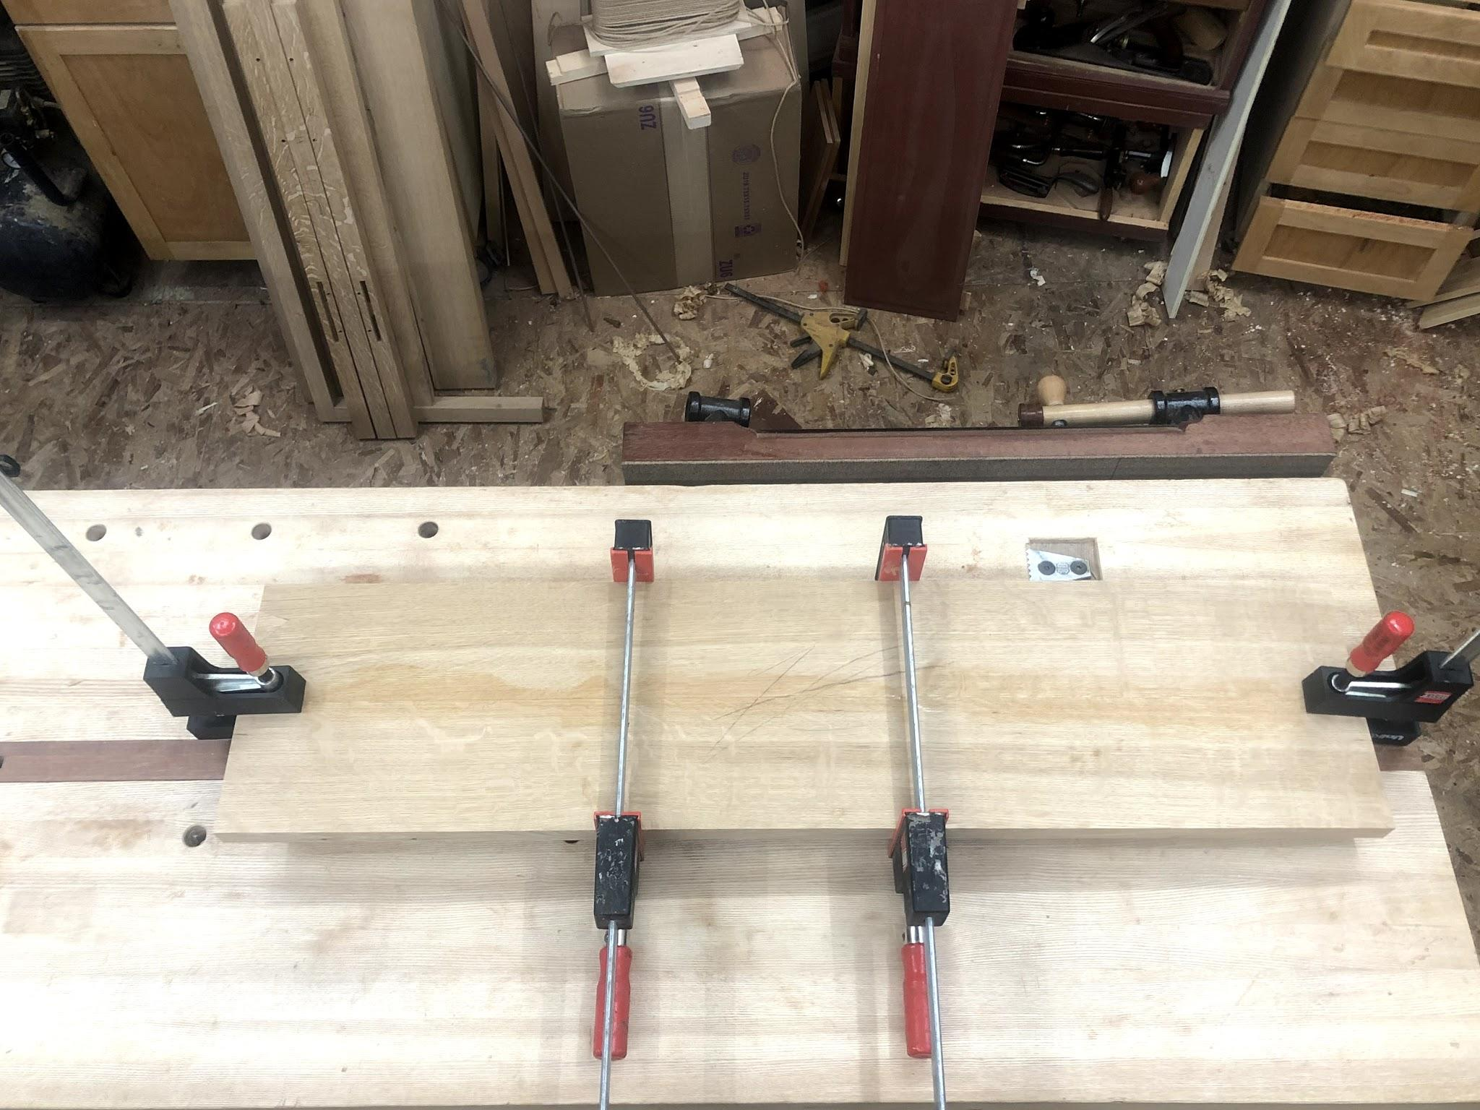
Tighter glue lines - Sprung Joints
With your stock already prepped - plane a slight cove along the length of the glue edges
Start in the middle with short, shallow pass
A few progressively longer strokes
A slight gap will appear when aligning the edges while the ends squarely touch
Handy when you have few clamps

