Slide 1
Laser Woodworking
A CNC Laser in the Shop Presented by Stephen Parsons May 8 2018
A CNC Laser in the Shop Presented by Stephen Parsons May 8 2018
Notes:
Every generation has its share of new technologies that allow us to work more efficiently, effectively, accurately, and creatively. Tool-making, whether the building of jigs and appliances like we will discuss later in this meeting or digital technologies like the one I am about to discuss continues to challenge and excite woodworkers and enable new design and production capabilities. Tonight I would like to give you a brief overview of the CNC laser in the shop – specifically about my use of the laser and I welcome any others in the audience to fill in some of their own experiences to enrich the discussion. Feel free to ask questions as we go – I may not have the answer but I know that we have several folks here who have used CNC machines, laser engravers or both in their shop and we may all learn from their input too. As far as my own experience goes, I am still a relative newbie and the laser I have brought tonight to demonstrate is a fairly moderate one compared to ones that others have used so my talk will focus on this level although I will briefly introduce the range of options to you in a moment.

Slide 2
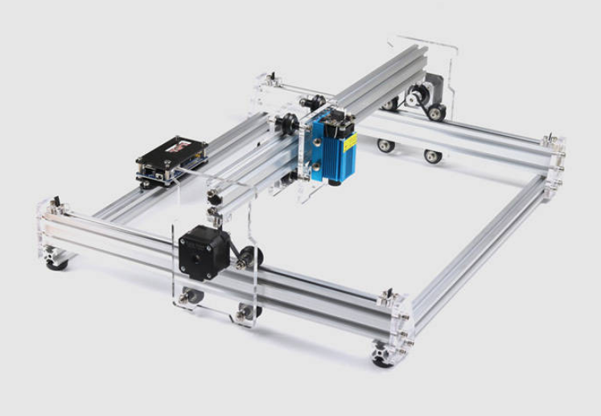
What is a CNC Laser?
CNC
Computer Numerically Controlled
Hardware
Software
Laser
High Intensity Light Source
Notes:
Let’s start with what this contraption is, then we can look at the features and feature range across all woodworking lasers, and then what it can do for a woodworker like you and me. To begin, what is a CNC Laser? Well, let’s take the terminology apart. The unit has two significant parts – a computer controlled mechanical device for either moving the laser over the material or the material under the laser; and a high intensity beam of light – a laser, capable of heating and vaporizing material.
Many of you would be familiar with a CNC machine. Typically we have seen CNCs in moderate shops attached to a router or other cutter. CNC stands for Computer Numerical Control, meaning that a computer is controlling the device with numerical instructions being sent to the machine through a software application. With CNC we typically see machines using vectors or lines and curves to cut patterns with a pattern bit installed in a routing device. CNCs can use 2-dimensional or three-dimensional instructions to cut shapes along two or three planes: IN two dimensional cutting where depth is set, the X and Y coordinates move the servo motors that control north-south and east-west movement of the cutter. In three dimensions, a third servo motor can move the cutter up and down to different depths – in a laser application, relief cutting like this is usually accommodated through varying time of exposure or intensity of the laser beam to vaporize more or less of the material.
The laser I will discuss in a bit more detail shortly, but basically it is a special device that creates intense light which can be focused through mirror and lenses to a very fine level creating a high level of energy at the point of focus. This intense light can very quickly heat and vaporize wood, paper, fabric and other materials and therefore can engrave and cut those materials and when used with the CNC controls can be very useful in quick and accurate cutting and engraving.

Slide 3
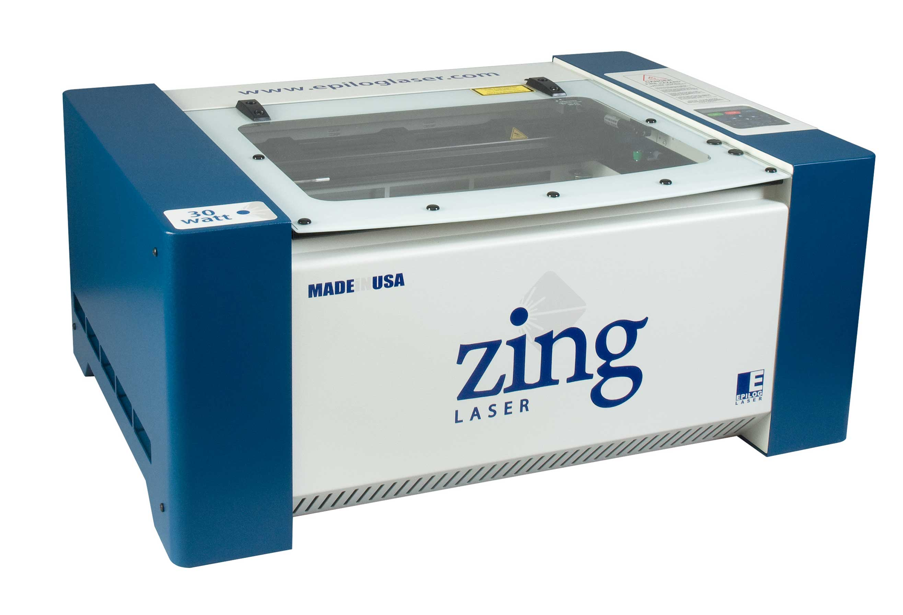
What is the Range of Features?
Medium (Gas/Fibre/Crystal)
Size (Footprint and Cutting Area)
Intensity/ Power
Precision/ Lens/ Controls
Engravable Materials
Accessories and Extras
Notes:
Range from very simple units that you have to assemble yourself to highly powerful and sophisticated units with lots of built in accessories and extras. If you are really well educated in electronics and programming, you can probably build a pretty decent laser yourself for $200-300 ordering parts from specialty supply houses. Kit lasers – basically ones that come with all components ready to go and you assemble yourself –range form a few hundred dollars to a couple of thousand. Commercial lasers like the Epilog Zing that I am showing here, can run from a couple of thousand to ten thousand or so, and even beyond for industrial applications. What makes the difference between a $200 laser and a $20,000 laser? Well it generally comes down to the capacity and features and so here are a few you have to think about.
Medium – most popular CO2
Size – also format laser moves over material or material passes below the laser
Intensity – usually in watts or milliwatts
Precision – the choice between belts and threaded rods is an important one, lens alone in a good machine could be as expensive as a small moderate laser machine
Materials – dependent to some degree on laser medium
Accessories – ability to engrave on round surfaces, exhaust systems

Slide 4
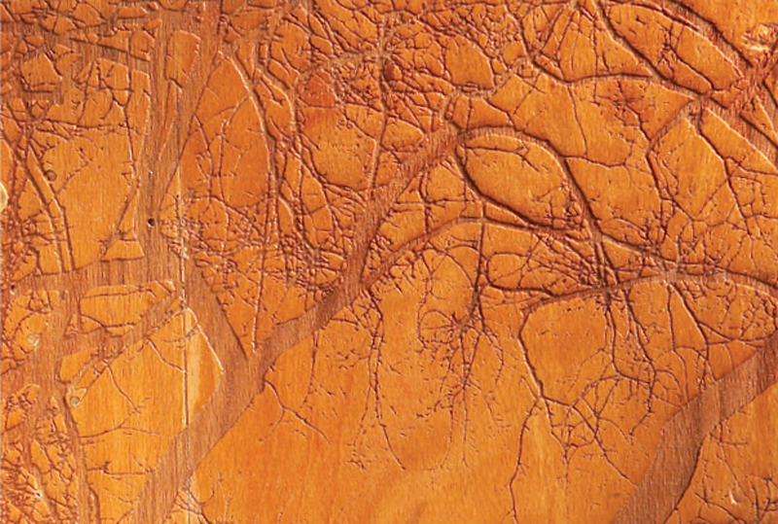
What Can a CNC Laser Do?
Engraving
Pattern Cutting
Relief Carving
Notes:
Engraving – most like a printer
- primarily embellishment of work
- marking for bandsaw/ scrollsaw
- adding functionality (show coasters)
- marketing, logos, etc. (adding a ruler to a jig)
Pattern Cutting – think of a very accurate bandsaw
- cutting of wooden parts especially thin parts
- Inlay, marquetry, intarsia
- cutting paper patterns, cloth, etc. (show cannon)
Relief carving – the CNC at its best
- 3d detail, or inlay
- reverse printing for stamps (show stamps)

Slide 5
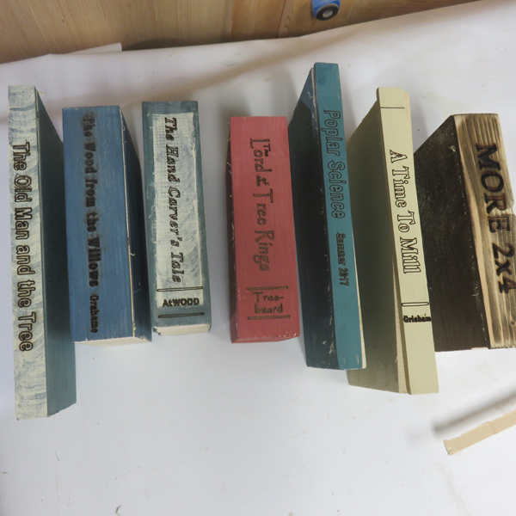
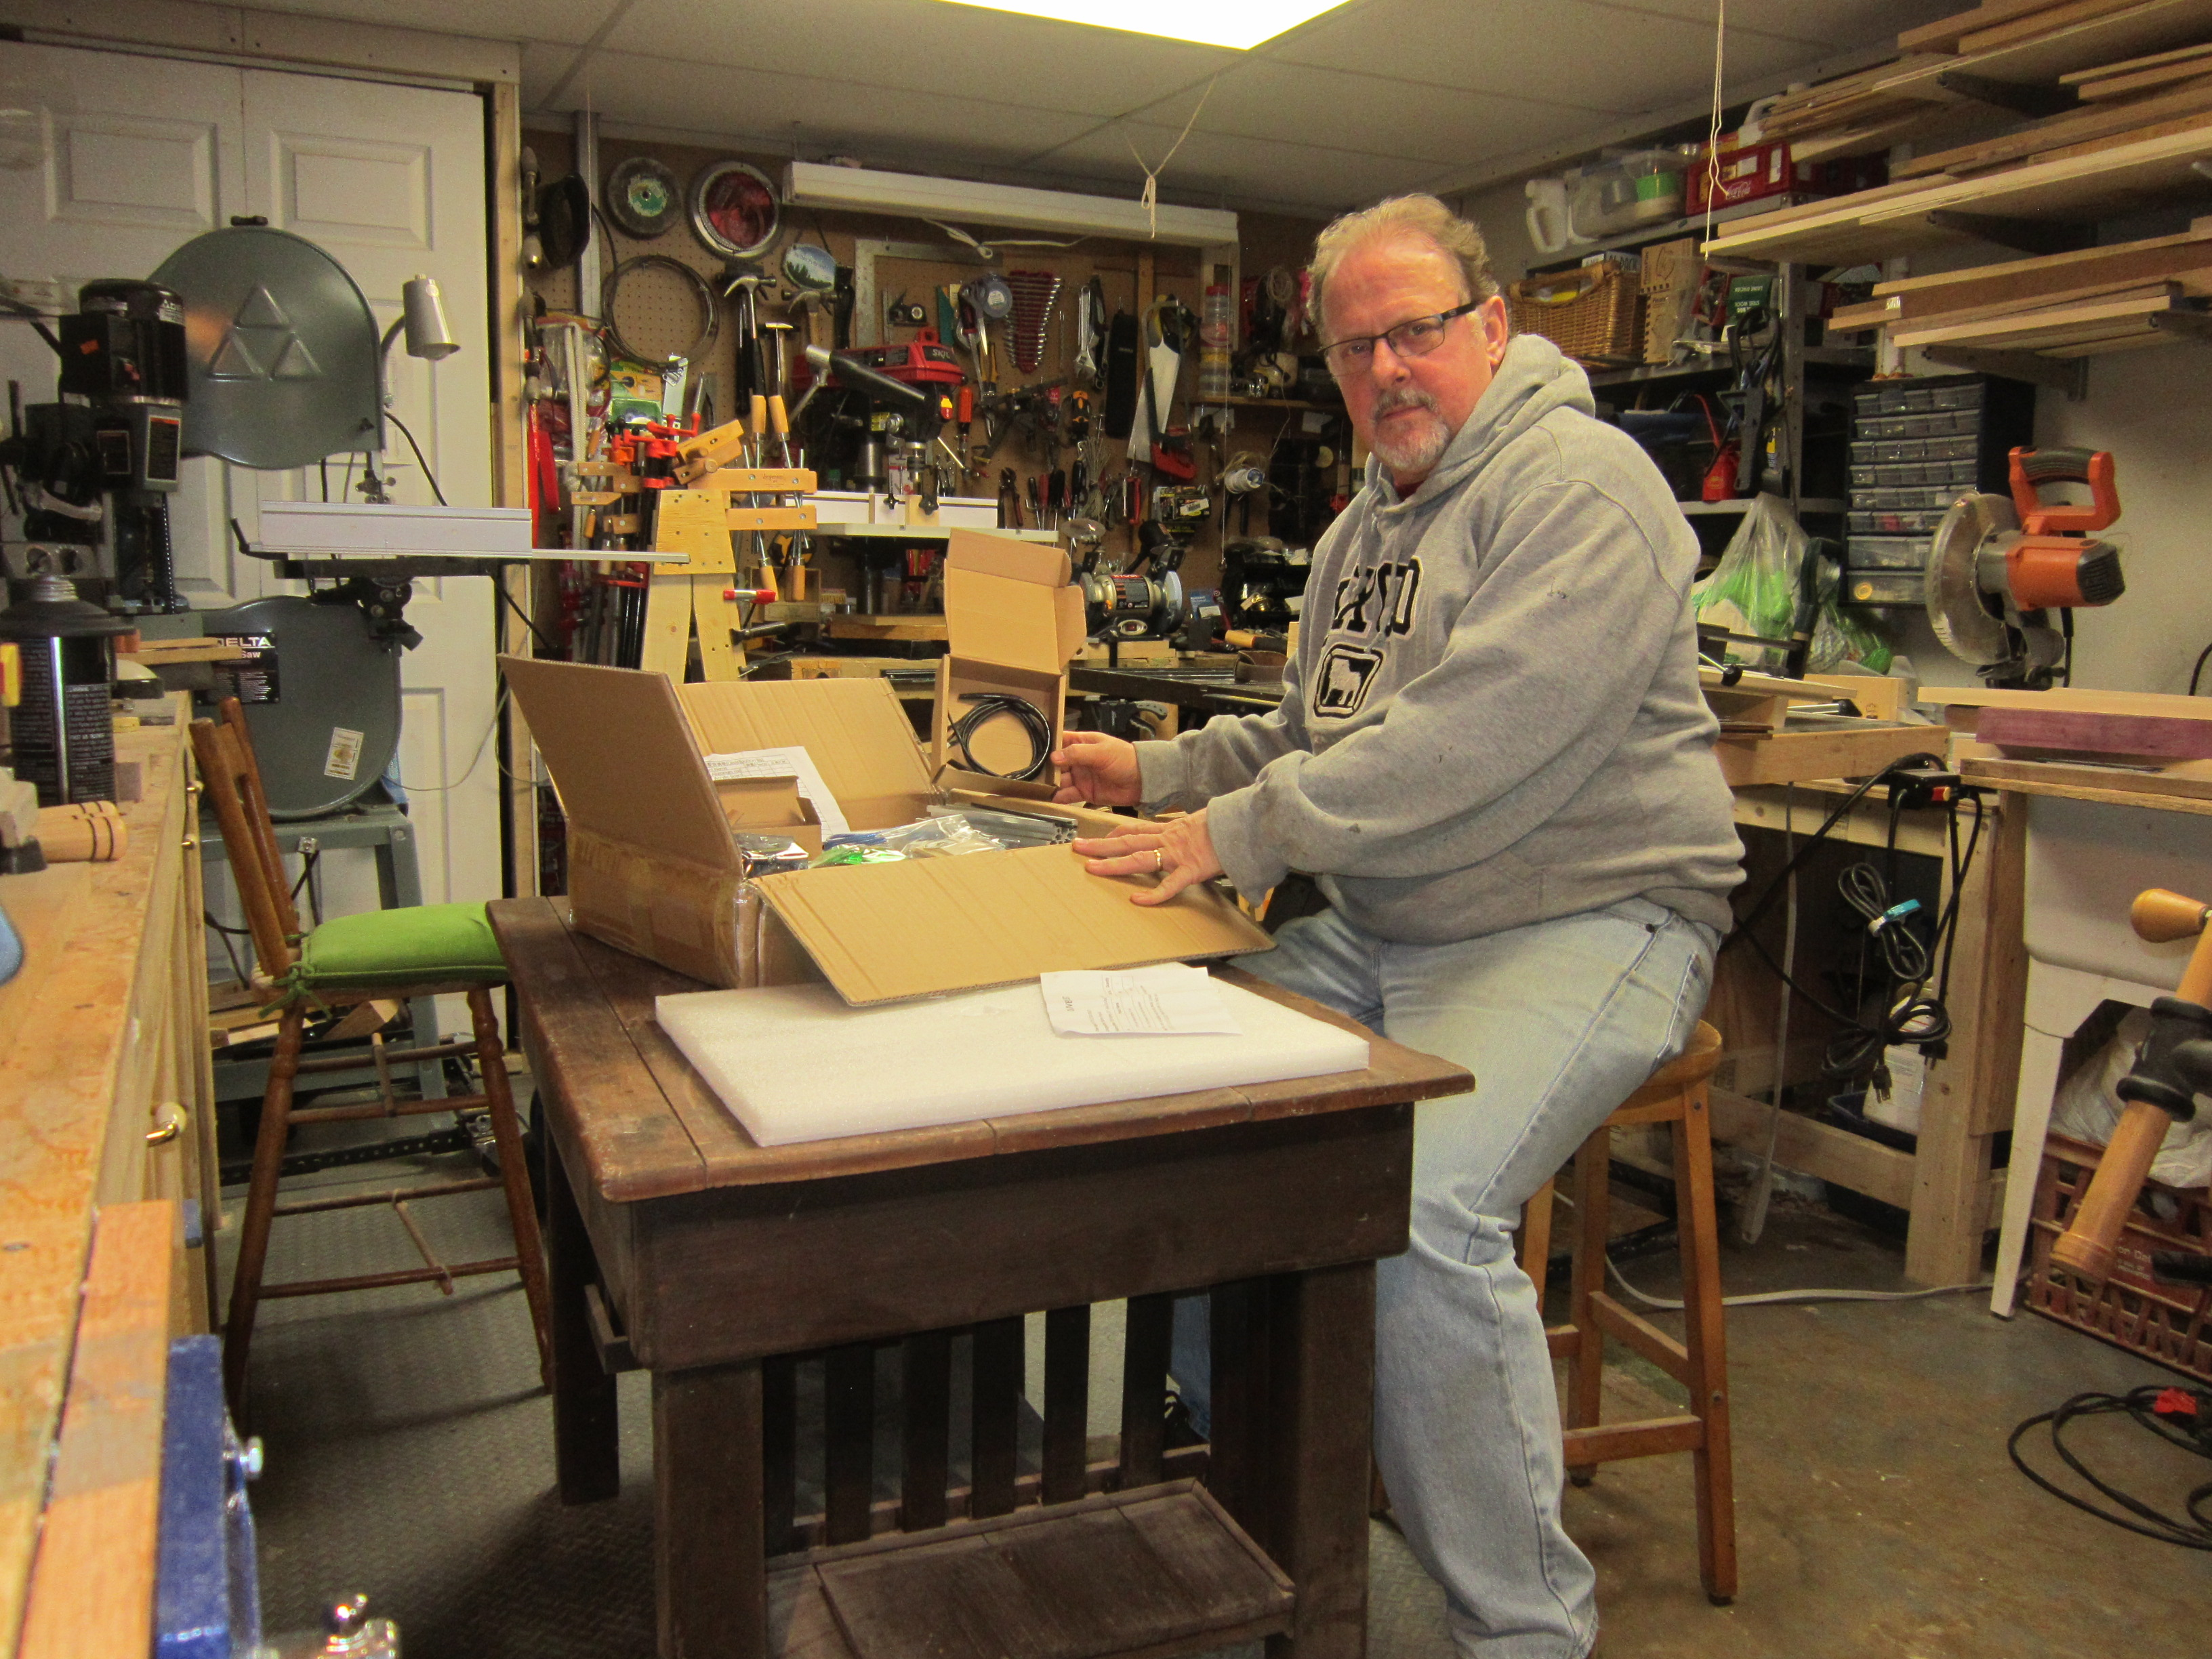
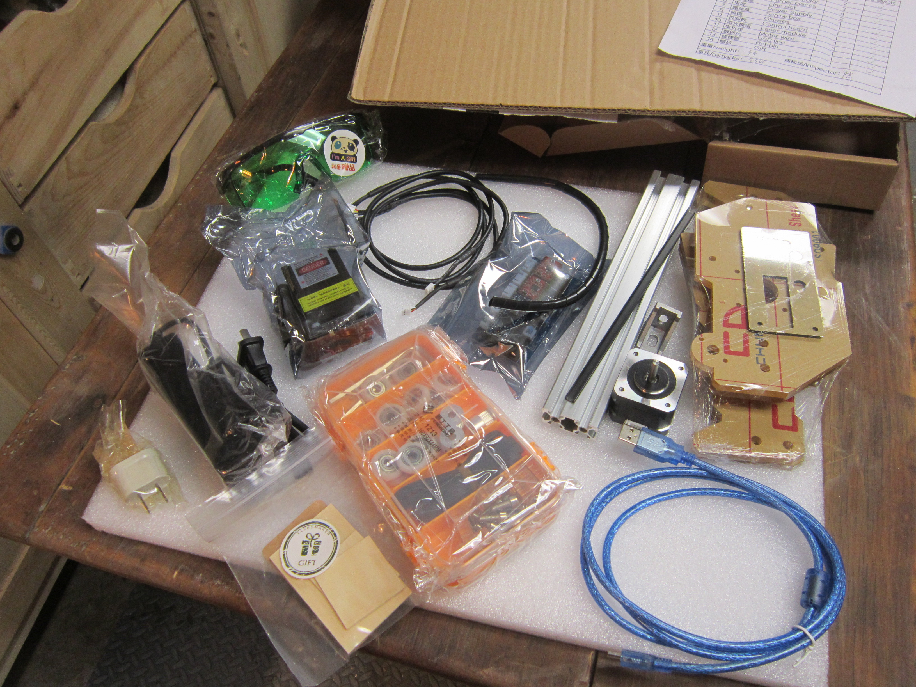
EleksLaser A3 Pro 5500mW Laser
The ChezCraft Laser
Some Assembly Required
A Home for Lex
A Few Good Projects
Notes:
The Laser Specs (Eleks A3 Pro 5.5w)
- 5.5watt blue light laser
- Banggood
- 24”x18”x 7”
- printing area 11” x 8” (new ones 18 x 12)
- 3.4 kg
- 12v5a power
- two stepper servo motors
- control – Arduino
- software: Benbox, T2 Laser
No Assembly Instructions
- lots of video, forums
Housing primarily to keep dust out, exhaust smoke
Projects – ME’s 2x4 contest, bbq scrapers, drink coasters, garden markers, cutting boards, logo inserts, rulers

Slide 6
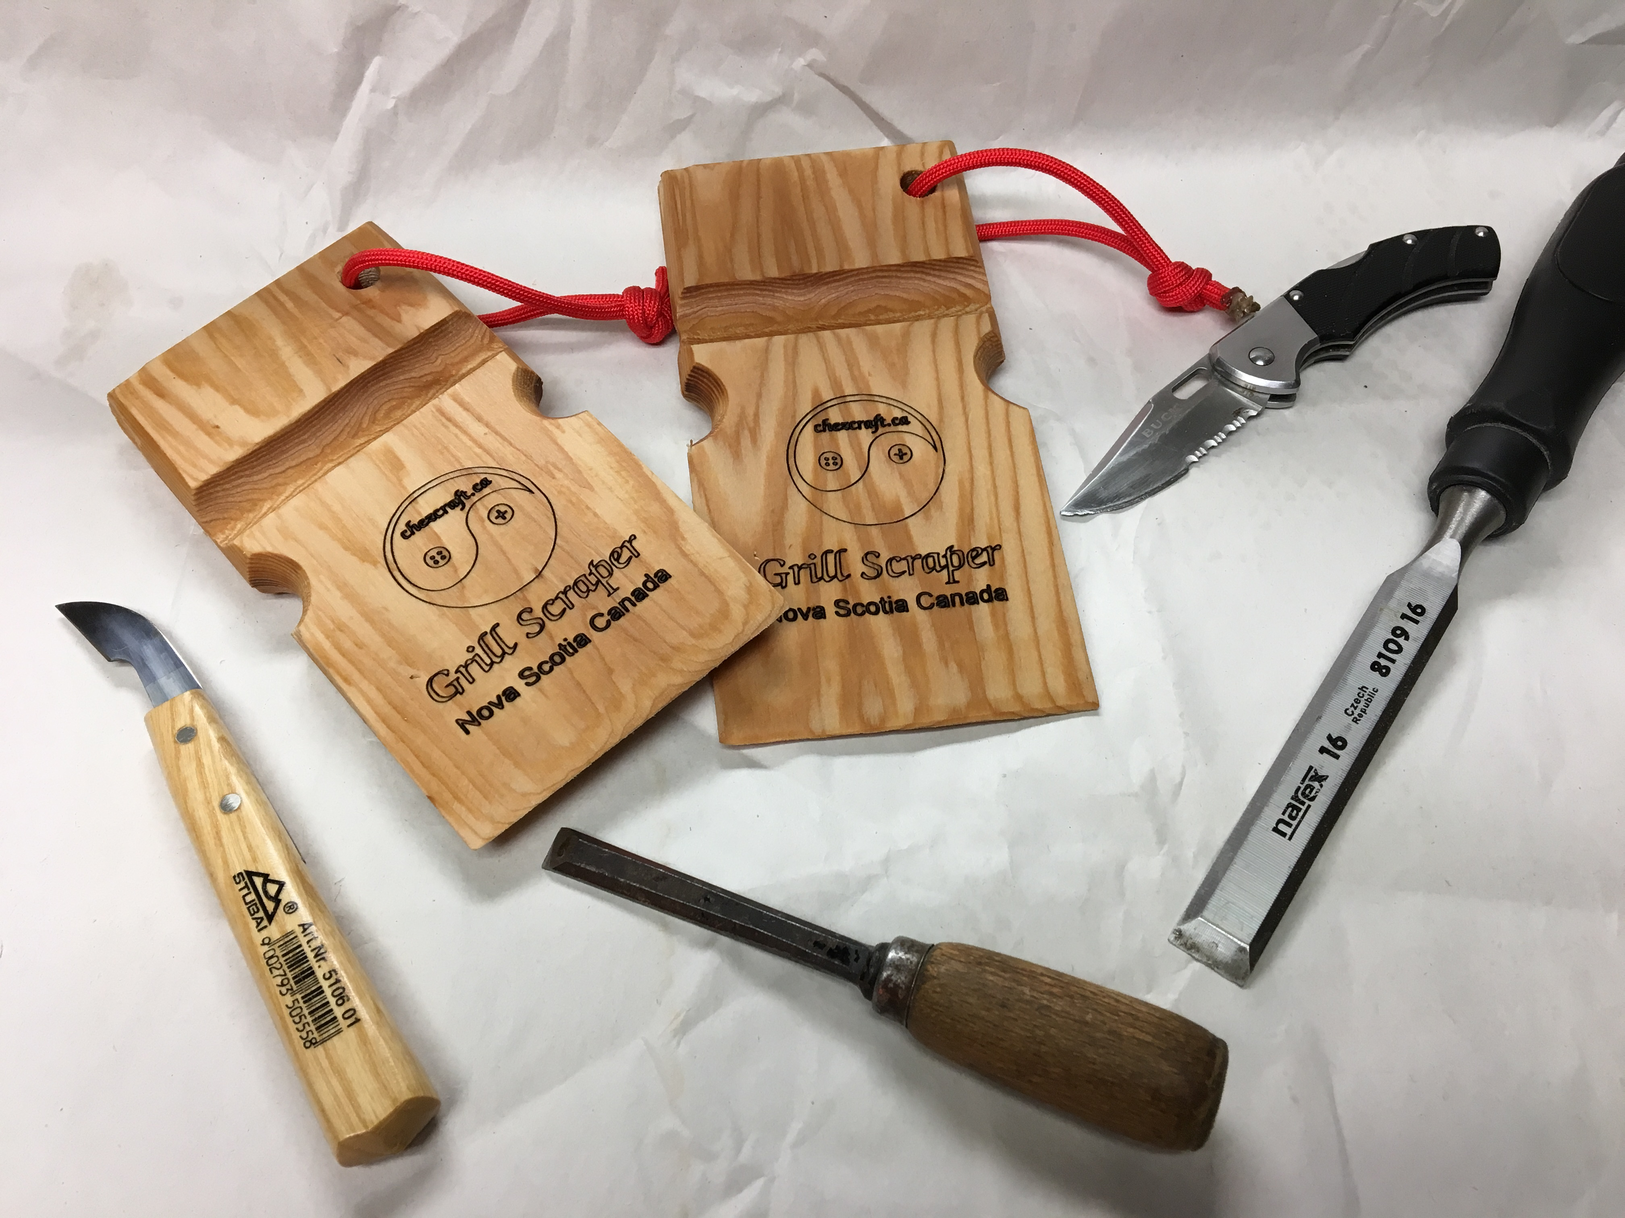
Demonstration
Lex at Work
Notes:
Determine size and location on product
Load imagery
Configure laser
Test and position (servo only)
Burn & Repeat

Slide 7
A Few Lessons Learned
WIIFM
Do the research/ ask colleagues/ try one out
Don’t be cheap, but look for sales
Consider threaded rod over belts
Software – you get what you pay for
Safety – smoke, fire, hands, and eyes
Notes:
In acquiring and testing out a small laser like this one, we have learned a few things that I hope might be of interest and maybe save you some time, money and headaches
WIIFM – what do you think you might do with a laser and how much of your work and business would count on it? If it is going to be substantial in volume and quality, then consider buying a really good laser at the higher end of the spectrum. If laser engraving is something you might use once in a while, save the money for a nice new Veritas plane or a new resaw blade for your bandsaw and contract someone like me or Trevor to do that little bit of work for you. In between those two ends you have room to decide on whether you want to get a small unit for your shop, rent one, or outsource whatever you need.
Do the homework before investing – ask someone who has one about their experience and maybe they’ll let you play with one for a while to see if it is something you may want to explore further. I am not unhappy with Lex, but it has its limitations. I am not interested in buying a larger laser right now, but might consider it in future if I see a lot of opportunity. There are good sales out there, but don’t go for anything less than a 4 or 5 watt laser. Anything less than that and you’ll only frustrate yourself.
Lex is driven using belts running over the servo wheels. They aren’t bad, but you can understand that if I tightened the belt on the left side a tiny bit tighter than the right side, I am going to have some issues with drawing straight lines and nice clean circles. Rods, because they are controlled by the thread per inch, will always be much more accurate as long as the servo motors and the controllers are pretty good.
The Chinese software is really awful, but its free so you get what you pay for, I guess. Getting a unit that comes with dedicated software might be even worse. If at all possible, try to select a system that will run on normal vector computer design applications like AutuCAD, CorelDraw, etc.
Of course, be safe –even a moderate unit like Lex needs to be treated with respect, the laser works by vaporizing wood, and if the time of exposure to the wood is significant, it can ignite the material – keep a fire extinguisher close and never leave the room with the unit working on wood. Be sure you can exhaust the smoke – especially when working with toxic woods, plastics and so on. Finally, keep in mind that this is a laser and it can burn you very quickly. The light is also very intense so always wear laser goggles when checking the work whiel the laser os going.

Slide 8
Q&A
Questions?
www.chezcraft.ca
Thanks!
This Photo by Unknown Author is licensed under CC BY-SA
Notes:
Well that’s about it for me – I am happy to take questions. Otherwise, feel free to come and have a look during the break and thanks you for your attention.

